Slide 1
Chapter Nine

Slide 2
Courtesy in Writing

Slide 3
If I have a billion dollars, I will…

Slide 4
I have a dream…

Slide 5
My ideal life…

Slide 6
What will China look like after 100 years?

Slide 7
What is Tianfu software park in your eyes?

Slide 8
If Lin Zhiling is my girlfriend…

Slide 9
Luisa, thanks for your email about the new brochure and the attached file with the quote from the printers. It is very expensive. Isn’t it a better idea to contact some other printing firms and get some alternative quotes? After all, we have been very unhappy with the quality of their work on the last few jobs. What do you think?
It seems / I think it’s quite / a bit / a little / rather expensive.
Wouldn’t it be a better idea…
We haven’t been very happy…

Slide 10
Frank, sorry we didn’t have a chance to talk yesterday. Actually, I have a favour to ask. I wonder if you can have a word with Sandra in Human Resources about when the position of Sales Director is going to be advertised. It’s delicate for me, as I’m sure you understand, because there is a chance I will be one of the candidates. Thanks.
Actually, I have small favour to ask.
I was wondering if you could …
It’s a bit delicate for me.
I might / may be one of the candidates.

Slide 11
Steven, thanks for sending the suggestions on how to price our new range of accessories. I don’t agree with you. The prices you suggest are too high for the market. Don’t you think a lower price will result in higher sales and therefore higher profits? Let me know what you think.
To be honest, I’m not sure I agree with you.
The prices you suggest seem to be / might be quite / a bit / a little / too high for the market.
Don’t you think a lower price would result in ….

Slide 12
IT Vocabulary
Validation 确认 verification 验证
Analysis分析 analyze分析
inspection审核 requirement需求
Document文档 design设计
Diagram图表 program程序
Source code源代码 implementation实施
Test case 测试用例 custom software 定制软件
Generic software通用软件 incorporate整合
Release发布 phase 阶段
Deliver交货 specification规约
Fault 错误 defect 缺陷
Crash崩溃 interaction 交互

Slide 13
Corruption 损坏 perform运行
Statement 说明 result结果
Generate生成 policy策略
Execute执行，运行 feature性能
Function功能 access访问
Figure数字 expect预期
Process过程 require要求
Menu菜单 user 用户

Slide 14
Within the Validation and Verification process, there are two complementary approaches to system checking and analysis.
Software inspections or peer reviews analyze and check system representations such as requirements document, design diagrams and program source code. You can use inspections at all stages of a testing process. Inspections may be supplemented by some automatic analysis of the source text of a system or associated documents. Software inspections and automated analysis are static V &V techniques, so you do not need to run the software on a computer.
Software testing involves running an implementation of the software with testing data. You examine the outputs of the software and its operational behavior to check if it is performing as required. Testing is a dynamic technique of verification and validation.

Slide 15
The software testing process has two distinct goals:
To demonstrate to the developer and the customer that the software meets its requirements. For custom software, there should be at least one test for every requirement in the user and system requirements documents. For generic software products, there should be tests for all of the system features. Such features will be incorporated in the product release. Some systems may have an explicit acceptance testing phase. In this phase, the customer formally checks the delivered system against its specification.
To discover faults or defects in the software. Defect testing is concerned with rooting out all kinds of undesirable system behaviors, such as system crashes, unwanted interactions with other systems, incorrect computations and data corruption.

Slide 16
Guest Reception

Slide 17
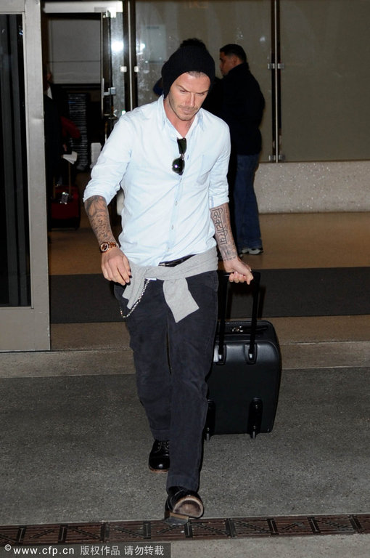
Meeting Sb at Airport

Slide 18
Useful Expressions
Confirm of the person’s name
Guess / presume/ You must be…
Self-introduction
I am here to meet you. /I’ve come to meet you. / I’m here to pick you up.
Greeting
Nice to meet you. / We are very happy to have you here.
Thank you for meeting me.
It’s my pleasure. Welcome to …

Slide 19
Inquiry (Flight, luggage, hungry)
How was your flight?
Did you have a good trip?
It’s long way to China, isn’t it?
Did you enjoy flight?
Long but quite comfortable.
It’s not bad except for a little turbulence.
Wonderful! Good food and good service.
Let me take your bag for you.
Let me help you with your luggage.
Would you like to have sth?
How to get back to the hotel?
Would you like to go to your hotel to rest and freshen up?
We’d better start for hotel. Our car is in the parking lots.
How long will it take from the airport to the hotel?
It will take / takes…

Slide 20
今 天下午我要去机场接一个客户。
I’m supposed to pick up a client at the airport this afternoon.
我猜你是基德曼女士吧。
Ms. Kidman, I presume. /Are you Ms. Kidman?
很高兴见到你。
It’s nice to meet you. / I’m pleased to meet you.
你的旅途顺利吗？
How was your flight?
谢谢你来机场接我。
Thank you for meeting me at the airport.
我来帮你拿包吧。
Let me take your bag for you. / Let me help you with your luggage.

Slide 21
我们去酒店吧。
Let’s start for hotel.
从这里到洒店大约需要一个小时的时间。
It takes around an hour to go from the airport to the hotel.
这是你第一次来韩国吗？
Is this your first time in South Korea?
你想吃点东西吗？
Would you like to have something?
我会告诉你明天的行程的。
I’ll let you know the schedule for tomorrow.
好好休息吧。
Get a good rest.

Slide 22
场景：
机场接客户
（问候、介绍、问行程、行李、稍后安排）

Slide 23
Example:
Mr. Li: You must be Ms. Rogers from Chicago?
Ms. Rogers: And you must be Mr. Li. Thank you for meeting me.
Mr. Li: It's my pleasure. Welcome to Taipei.
Ms. Rogers: It's good to be here.
Mr. Li: How was your flight?
Ms. Rogers: Long, but quite comfortable. China Airlines treats its passengers well.
Mr. Li: Did you have any trouble clearing customs?
Ms. Rogers: Oh no. They were quite quick and efficient.
Mr. Li: I've got a company car waiting. Would you like to go to your hotel to rest and freshen up? Then perhaps later on this afternoon we could start our business discussions.
Ms. Rogers: That sounds fine. How long will it take from the airport to the hotel?
Mr. Li: About an hour, depending on traffic.
Ms. Rogers: Will I be meeting any other members of your company?
Mr. Li: Perhaps you'd like to continue our discussions over dinner tonight. That would give some of our other staff members a chance to meet you.
Ms. Rogers: That sounds like a wonderful idea.

Slide 24
Ms. Lin: Hello, Mr. Brown. Mr. Brown: Hello, Lin. Ms. Lin: It's nice to see you again in Shanghai. Mr. Brown: Well, I'm so glad to be able to come here again. Ms. Lin: How was your flight? Mr. Brown: Just wonderful! Good food and good service. Ms. Lin: Now, Mr. Brown, if all is ready, we'd better start for the hotel. Mr. Brown: I'd like to. Let's go. Ms. Lin: This way, please. Our car is in the parking lots. Mr. Brown: OK ... But Ms. Lin, the airport looks different from what I saw last time. Ms. Lin: Your last time was two years ago, right? Ms. Lin: In the past two years, Shanghai has speeded up the expansion project of the Pudong Airport. You'll see more changes elsewhere. Mr. Brown: That's why I like Shanghai immensely.

Slide 25

Giving banquet

Slide 26
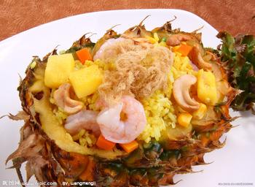
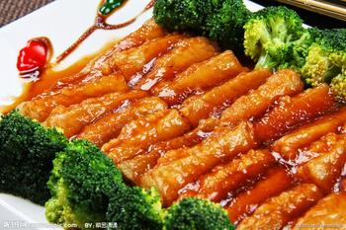
Dishes
Cooking method + main material + sauce
Shape +main material
Flavor +main material

Slide 27
四季豆 string bean
豆芽 bean sprout
芹菜 celery
菠菜 spinach
韭菜 leek
丝瓜 loofah
南瓜 pumpkin
苦瓜 bitter gourd
黄瓜cucumber
冬瓜 white gourd
茄子 eggplant
藕 lotus root
金针菇 needle mushroom

Slide 28
Cooking method +main material+sauce
Shape +main material
Flavor +main material

Slide 29
炖 stew
炒 fry
烧 braise
蒸 steam
烤 roast / bake

Slide 30
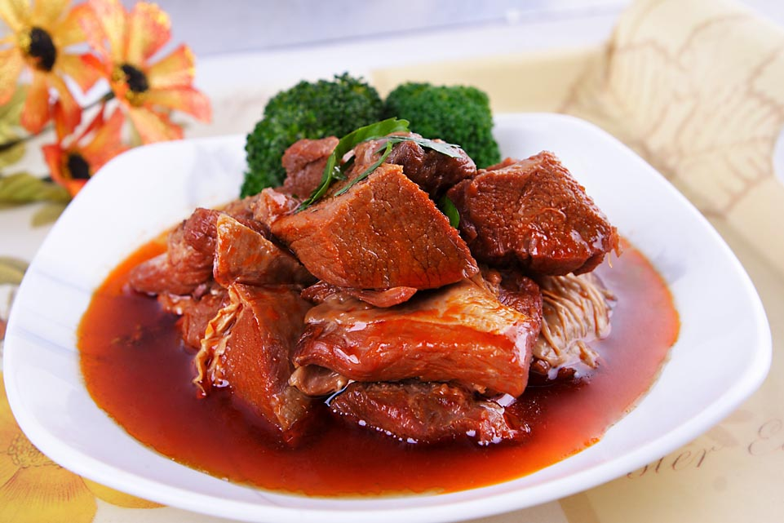
红烧牛肉
Braised beef with brown sauce

Slide 31
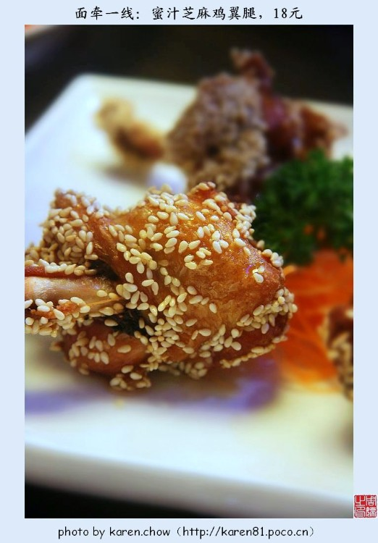
芝麻酥鸡
Crisp chicken with sesame

Slide 32
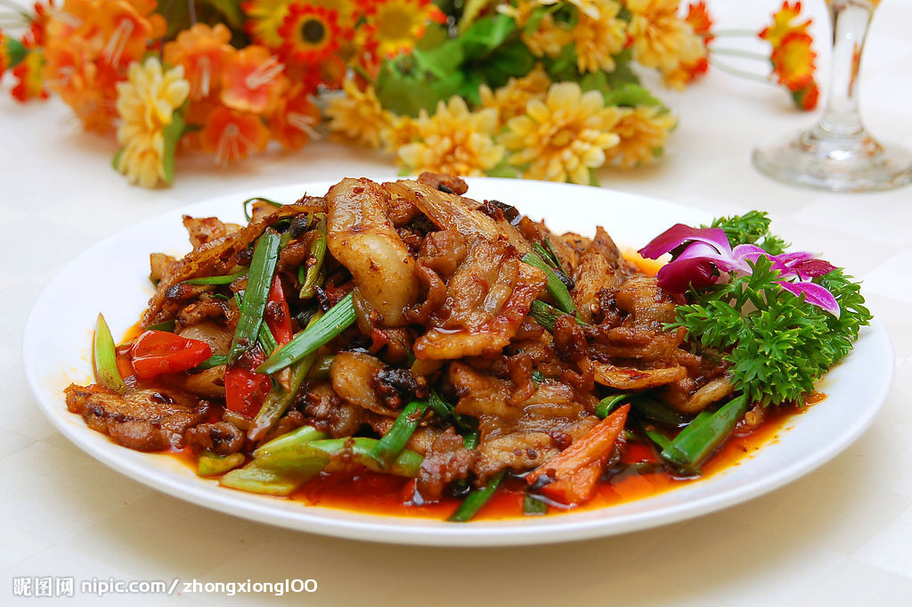
回锅肉
Twice-cooked pork slice

Slide 33
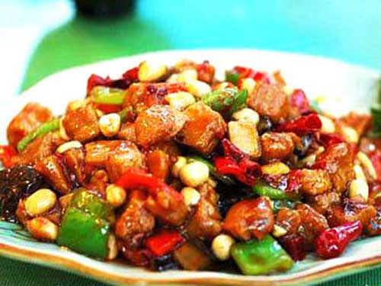
宫保鸡丁
Spicy diced chicken with peanuts

Slide 34
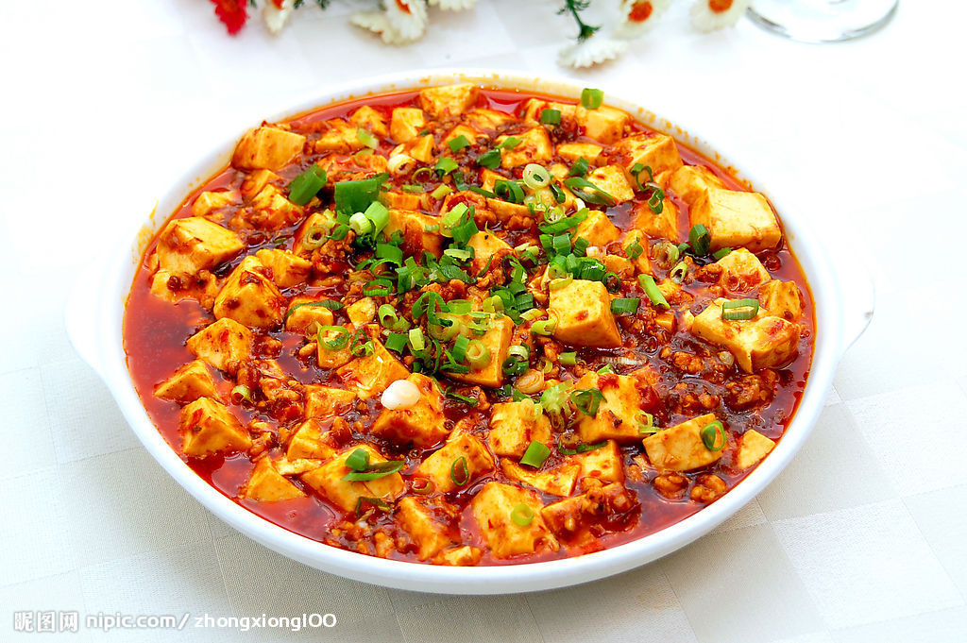
麻婆豆腐
Ma po beancurd

Slide 35
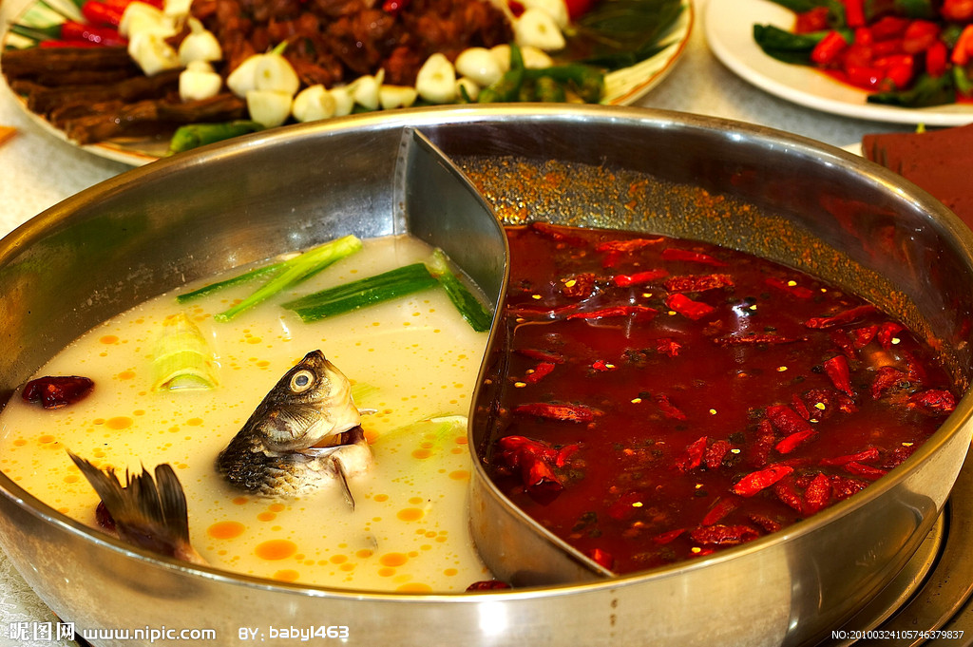
火锅
hotpot

Slide 36
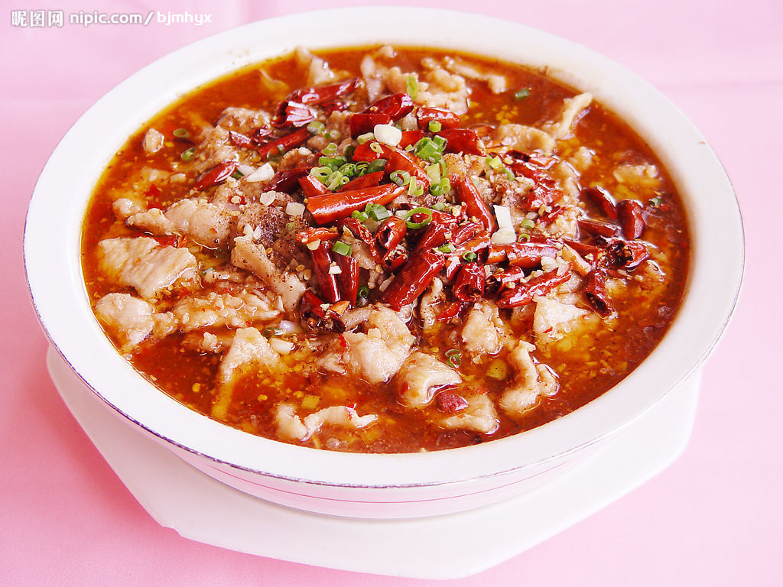
水煮肉片
Chili water boiled beef slices

Slide 37
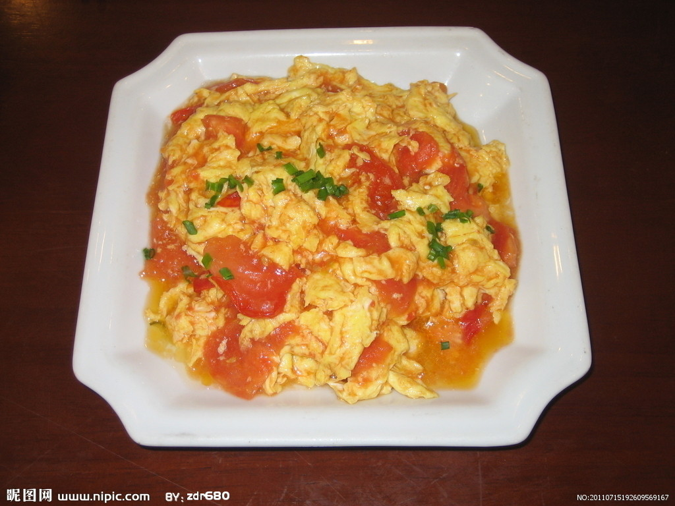
蕃茄炒蛋
Scrambled egg with tomato

Slide 38
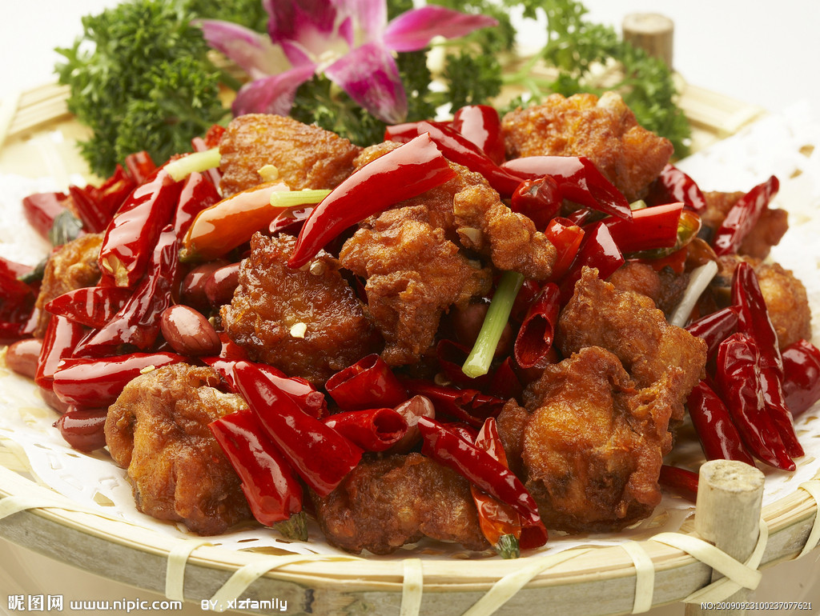
辣子鸡
Spicy chicken

Slide 39
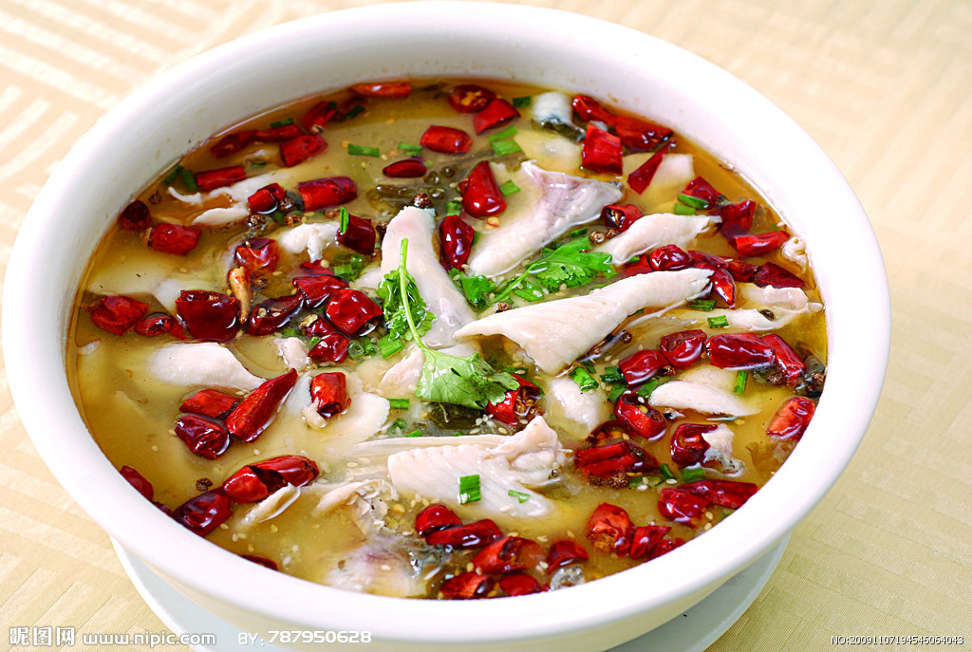
酸菜鱼
Boiled fish with pickled cabbage and chili

Slide 40
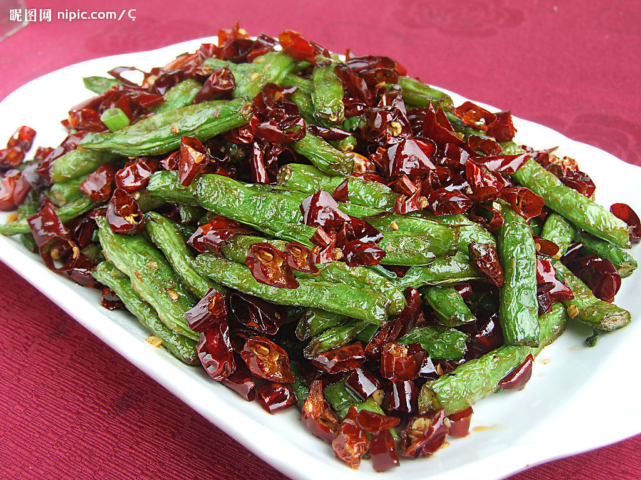
干煸四季豆
dry fried string beans

Slide 41
Invite:
I wonder if you are free...
I wonder if you’ve had any plans…
Plan:
We’d like to invite you to the banquet held in your honor...
I’d like to hold a dinner in your honor.
Respond:
I’d be delighted to come.
I’m pleased to come.

Slide 42
Time:
I’ll pick you up at …
Complimentary close:
We shall be honored by your presence.
Looking forward to seeing you there.

Slide 43
你明晚上有空吗？
I wonder if you are free tomorrow evening.
I wonder if you’ve had any plans for tomorrow evening.
我们董事长要我来邀请您参加晚上七点在北京饭店为您举办的宴会
Our president has asked me to come over to invite you to the banquet held in your honor at the Beijing Hotel 7:00.
那我就设宴为你洗尘
I’d like to hold a dinner in your honor.
请你的夫人今晚一起来
Please ask your wife to join us for dinner tonight.
我很高兴前往
I’d be delighted to come.
你想得可真周到
It’s very thoughtful of you.
六点半我到这里来接你
I’ll be there to pick you up at 6:30.
如蒙光临，不胜荣幸
We shall be greatly honored by your gracious presence.

Slide 44
What would you like to have?
Which kind of meat do you like?
Are there any types of food you really don’t like?
Would you like anything else?
I’m not familiar to the name of the food. I’m at your disposal.
Why not?
That sounds fine.
It’s interesting. Let’s have some.
I’d like to make a toast to our business.
On behalf of my corporation, may I propose a toast to you?

Slide 45

What would you like to drink?
How much can you drink?
I’m a moderate drinker.
I drink like a fish. / I’m a heavy drinker.
I am a teetotaler. / I do not drink at all.
I’ll have sth milder, if you don’t mind.
It suits my taste.
It’s strong/light.

Slide 46

Let me fill your cup.
Just a little or I’ll get drunk.
Please help yourself. / please enjoy your meal.
You should give it a try.

Slide 47
It’s delicious.
It tastes great.
It’s out of this world.
This meal is fit for a king.
This meal was made in heaven.
I couldn’t ask for a better meal.

Slide 48
Practice
Scenario 1: your manager asked you to invite Beckham to dinner
(time, place, how to get there)
Scenario 2: have dinner with Beckham
(introduction of dishes and drinks, expressing thanks, make a toast)

Slide 49
Linking Words

Slide 50
Showing sequence:
Firstly, Secondly, Finally
Talking generally:
In general, On the whole, Usually
Making contrast:
However, Nevertheless, On the other hand
Adding another point:
In addition, Moreover, On another point
Giving an example:
For example, e.g. For instance
Giving an alternative:
Either … or …, Alternatively, Instead of

Slide 51
Saying what the real situation is:
In fact, Actually, As a matter of fact
Saying something is obvious:
Clearly, Obviously, Of course
Giving the most important point:
Especially, Above all, In particular
Rephrasing in a different way:
In other words, That’s to say, i.e.
Giving a result / consequence:
As a result, For this reason, Therefore,
Introducing a new topic:
In relation to, Regarding, With reference to

Slide 52
关于最新的市场数据，我们可以看出其在下降。
With regard to the latest market figures we can see that they are decreasing.
对于约翰的想法，我们看看他发给我的报告。
As for John's thoughts, let's take a look at this report he sent me.
我们一直稳步提升我们的客服中心，另一方面我们的运输部门也需重新设计。
On the one hand we've been steadily improving our customer service center. On the other hand our shipping department needs to be redesigned.
杰克认为我们可以开始了，但汤姆觉得我们还需等等。
Jack thinks we're ready to begin whereas Tom thinks we still need to wait.
吸烟被证明有害健康，但仍有40%的人吸烟。
Smoking is proved to be dangerous to health. Nonetheless, 40% of the population smokes.

Slide 53
老师承诺给我们一次音乐课，上周却改变了主意。
Our teacher promised to give us a music class. However, he changed his mind last week.
我向他保证会参加他的演讲。另外，我还邀请了一些公司的重要代表。
I assured him that I would come to his presentation. Furthermore, I also invited a number of important representatives from some companies.
他减少了学习时间，结果考试分非常低。
He reduced the amount of studying time. As a result, his marks were rather low.
政府大量缩减开支，许多项目因此而被取消。
The government has drastically reduced its spending. Therefore, a number of programs have been canceled.

Slide 54
I am writing to complain about the poor service we have received from your company. _________, the goods you sent were not the ones that we ordered. Our order dated 16 September clearly stated that we wanted 1,000 t-shirts. _________, we only received 800. ________, we asked you to print our company logo in the top left corner of the shirts and you have printed it in the centre.
To make matters worse, your staff were very unhelpful when I called. _________, no one took responsibility to sort out the problem – I was simply passed from person to person. _________, after 30 minutes I gave up in frustration and ended the call.
The whole matter was treated by your staff as though it was completely unimportant, _________________ we have been your customers for more than five years. _________, we are considering stopping all future business with your company.
__________________________, we must insist on an immediate replacement order, to reach here within 14 working days, at no cost to ourselves.
Firstly
However
Furthermore
Above all
In fact
In spite of the fact that
As a result
Taking everything into consideration

